Slide 1
KERAS VS TENSORFLOW

Slide 2
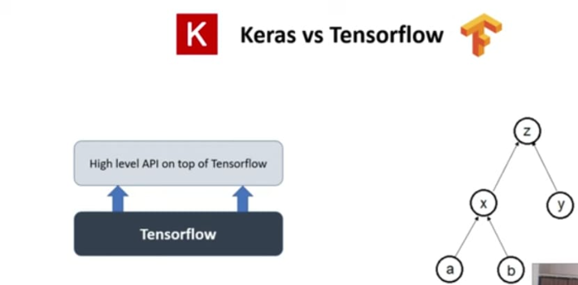

Slide 3
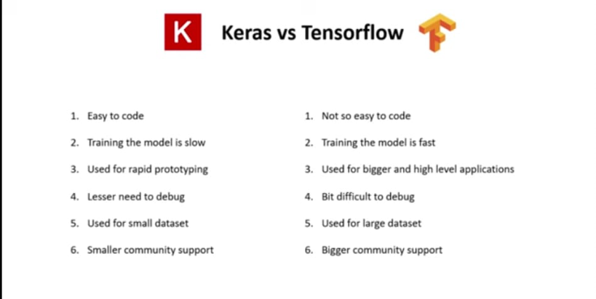

Slide 4
